Slide 1
Lecture 1
Intro to Crypto and Cryptocurrencies

Slide 2




Welcome
Joseph Bonneau
Ed Felten
Arvind Narayanan
special guest:
Andrew Miller

Slide 3
This lecture
Crypto background
hash functions
digital signatures
… and applications
Intro to cryptocurrencies
basic digital cash

Slide 4
Lecture 1.1:
Cryptographic Hash Functions
Notes:
This is going to be kinda mathy. Sorry about that. I’ll do my best to tell you just what you need to know, and approach things intuitively. Those who want all of the formal mathy details will have to do some more reading.

Slide 5
Hash function:
takes any string as input
fixed-size output (we’ll use 256 bits)
efficiently computable
Security properties:
collision-free
hiding
puzzle-friendly

Slide 6
Hash property 1: Collision-free
Nobody can find x and y such that
x != y and H(x)=H(y)
x
H(x) = H(y)
y

Slide 7
Collisions do exist ...
possible outputs
possible inputs
… but can anyone find them?

Slide 8
How to find a collision
try 2¹³⁰ randomly chosen inputs
99.8% chance that two of them will collide
This works no matter what H is …
… but it takes too long to matter

Slide 9
Is there a faster way to find collisions?
For some possible H’s, yes.
For others, we don’t know of one.
No H has been proven collision-free.

Slide 10
Application: Hash as message digest
If we know H(x) = H(y),
it’s safe to assume that x = y.
To recognize a file that we saw before,
just remember its hash.
Useful because the hash is small.

Slide 11

Hash property 2: Hiding
We want something like this:
Given H(x), it is infeasible to find x.
H(“heads”)
easy to find x!
H(“tails”)

Slide 12
Hash property 2: Hiding
Hiding property:
If r is chosen from a probability distribution that has high min-entropy, then given H(r | x), it is infeasible to find x.
High min-entropy means that the distribution is “very spread out”, so that no particular value is chosen with more than negligible probability.

Slide 13
Application: Commitment
Want to “seal a value in an envelope”, and
“open the envelope” later.
Commit to a value, reveal it later.

Slide 14
Commitment API
(com, key) := commit(msg)
match := verify(com, key, msg)
To seal msg in envelope:
(com, key) := commit(msg) -- then publish com
To open envelope:
publish key, msg
anyone can use verify() to check validity

Slide 15
Commitment API
(com, key) := commit(msg)
match := verify(com, key, msg)
Security properties:
Hiding: Given com, infeasible to find msg.
Binding: Infeasible to find msg != msg’ such that
verify(commit(msg), msg’) == true

Slide 16
Commitment API
commit(msg) := ( H(key | msg), H(key) )
where key is a random 256-bit value
verify(com, key, msg) := ( H(key | msg) == com )
Security properties:
Hiding: Given H(key | msg), infeasible to find msg.
Binding: Infeasible to find msg != msg’ such that
H(key | msg) == H(key | msg’)

Slide 17
Hash property 3: Puzzle-friendly
Puzzle-friendly:
For every possible output value y,
if k is chosen from a distribution with high min-entropy,
then it is infeasible to find x such that H(k | x) = y.

Slide 18
Application: Search puzzle
Given a “puzzle ID” id (from high min-entropy distrib.),
and a target set Y:
Try to find a “solution” x such that
H(id | x) ∈ Y.
Puzzle-friendly property implies that no solving strategy is much better than trying random values of x.

Slide 19
SHA-256 hash function
Padding (10* | length)
512 bits
Message
(block 1)
Message
(block 2)
Message
(block n)
256 bits
256 bits
c
c
c
IV
Hash
Theorem: If c is collision-free, then SHA-256 is collision-free.

Slide 20
Lecture 1.2:
Hash Pointers and Data Structures

Slide 21
hash pointer is:
* pointer to where some info is stored, and
* (cryptographic) hash of the info
if we have a hash pointer, we can
* ask to get the info back, and
* verify that it hasn’t changed

Slide 22
H( )
(data)
will draw hash pointers like this

Slide 23
key idea:
build data structures with hash pointers

Slide 24
linked list with hash pointers = “block chain”
H( )
prev: H( )
prev: H( )
prev: H( )
data
data
data
use case: tamper-evident log

Slide 25
detecting tampering
H( )
prev: H( )
prev: H( )
prev: H( )
data
data
data
use case: tamper-evident log

Slide 26
binary tree with hash pointers = “Merkle tree”
H( ) H( )
H( ) H( )
H( ) H( )
H( ) H( )
H( ) H( )
H( ) H( )
H( ) H( )
(data)
(data)
(data)
(data)
(data)
(data)
(data)
(data)

Slide 27
proving membership in a Merkle tree
show O(log n) items
H( ) H( )
H( ) H( )
H( ) H( )
(data)

Slide 28
Advantages of Merkle trees
Tree holds many items
but just need to remember the root hash
Can verify membership in O(log n) time/space
Variant: sorted Merkle tree
can verify non-membership in O(log n)
(show items before, after the missing one)

Slide 29
More generally ...
can use hash pointers in any pointer-based
data structure that has no cycles

Slide 30
Lecture 1.3:
Digital Signatures

Slide 31
What we want from signatures
Only you can sign, but anyone can verify
Signature is tied to a particular document
can’t be cut-and-pasted to another doc

Slide 32
API for digital signatures
(sk, pk) := generateKeys(keysize)
sk: secret signing key
pk: public verification key
sig := sign(sk, message)
isValid := verify(pk, message, sig)
can be
randomized
algorithms

Slide 33
Requirements for signatures
“valid signatures verify”
verify(pk, message, sign(sk, message)) == true
“can’t forge signatures”
adversary who:
knows pk
gets to see signatures on messages of his choice
can’t produce a verifiable signature on another message

Slide 34

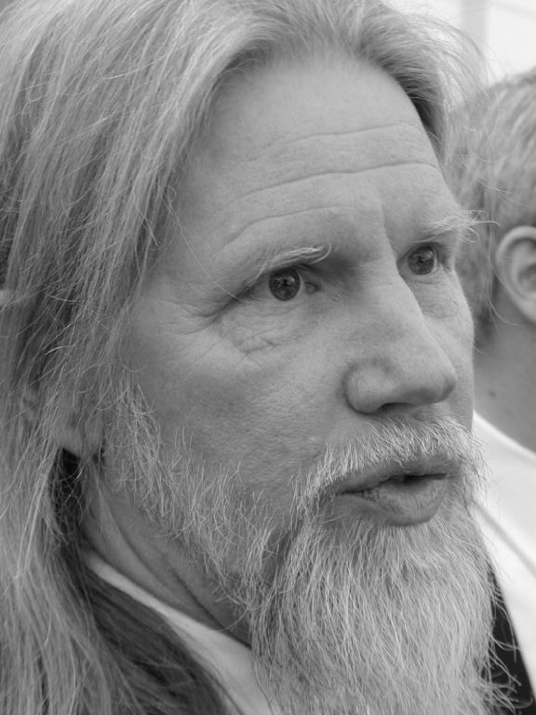
(sk, pk)
challenger
attacker
m₀
sign(sk, m₀)
m₁
sign(sk, m₁)
. . .
M, sig
M not in { m₀, m₁, … }
verify(pk, M, sig)
if true, attacker wins

Slide 35
Practical stuff...
algorithms are randomized
need good source of randomness
limit on message size
fix: use Hash(message) rather than message
fun trick: sign a hash pointer
signature “covers” the whole structure

Slide 36

Bitcoin uses ECDSA standard
Elliptic Curve Digital Signature Algorithm
relies on hairy math
will skip the details here --- look it up if you care
good randomness is essential
foul this up in generateKeys() or sign() ?
probably leaked your private key

Slide 37
Lecture 1.4:
Public Keys as Identities

Slide 38
Useful trick: public key == an identity
if you see sig such that verify(pk, msg, sig)==true,
think of it as
pk says, “[msg]”.
to “speak for” pk, you must know matching secret key sk

Slide 39
How to make a new identity
create a new, random key-pair (sk, pk)
pk is the public “name” you can use
[usually better to use Hash(pk)]
sk lets you “speak for” the identity
you control the identity, because only you know sk
if pk “looks random”, nobody needs to know who you are

Slide 40
Decentralized identity management
anybody can make a new identity at any time
make as many as you want!
no central point of coordination
These identities are called “addresses” in Bitcoin.

Slide 41
Privacy
Addresses not directly connected to real-world identity.
But observer can link together an address’s activity over time, make inferences.
Later: a whole lecture on privacy in Bitcoin ...

Slide 42
Lecture 1.5:
Simple Cryptocurrencies

Slide 43

GoofyCoin

Slide 44
Goofy can create new coins
New coins belong to me.
signed by pk_{Goofy}
CreateCoin [uniqueCoinID]

Slide 45
A coin’s owner can spend it.
Alice owns it now.
signed by pk_{Goofy}
Pay to pk_{Alice} : H( )
signed by pk_{Goofy}
CreateCoin [uniqueCoinID]

Slide 46

The recipient can pass on the coin again.
signed by pk_{Alice}
Bob owns it now.
Pay to pk_{Bob} : H( )
signed by pk_{Goofy}
Pay to pk_{Alice} : H( )
signed by pk_{Goofy}
CreateCoin [uniqueCoinID]

Slide 47
double-spending attack
signed by pk_{Alice}
signed by pk_{Alice}
Pay to pk_{Bob} : H( )
Pay to pk_{Chuck} : H( )
signed by pk_{Goofy}
Pay to pk_{Alice} : H( )
signed by pk_{Goofy}
CreateCoin [uniqueCoinID]

Slide 48
double-spending attack
the main design challenge in digital currency

Slide 49

ScroogeCoin

Slide 50
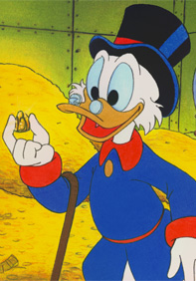
Scrooge publishes a history of all transactions
(a block chain, signed by Scrooge)
H( )
prev: H( )
prev: H( )
prev: H( )
transID: 71
transID: 72
transID: 73
trans
trans
trans
optimization: put multiple transactions in the same block

Slide 51
CreateCoins transaction creates new coins
Valid, because I said so.
transID: 73 type:CreateCoins
coins created
num | value | recipient
0 | 3.2 | 0x...
1 | 1.4 | 0x...
2 | 7.1 | 0x...
coinID 73(0)
coinID 73(1)
coinID 73(2)

Slide 52
PayCoins transaction consumes (and destroys) some coins,
and creates new coins of the same total value
transID: 73 type:PayCoins
consumed coinIDs:
68(1), 42(0), 72(3)
Valid if:
-- consumed coins valid,
-- not already consumed,
-- total value out = total value in, and
-- signed by owners of all consumed coins
coins created
num | value | recipient
0 | 3.2 | 0x...
1 | 1.4 | 0x...
2 | 7.1 | 0x...
signatures

Slide 53
Immutable coins
Coins can’t be transferred, subdivided, or combined.
But: you can get the same effect by using transactions
to subdivide: create new trans
consume your coin
pay out two new coins to yourself

Slide 54
Don’t worry, I’m honest.
Crucial question:
Can we descroogify the currency, and operate without any central, trusted party?

